Slide 1

Small Area Estimation - An applied approach -
Training based on Guidelines to small area estimation for poverty mapping
Equity Policy Lab (EPL)
Poverty and Equity GP
Paul Corral Rodas (pcorralrodas@worldbank.org)
Sandra Segovia Juarez (ssegoviajuarez@worldbank.org)

Slide 2
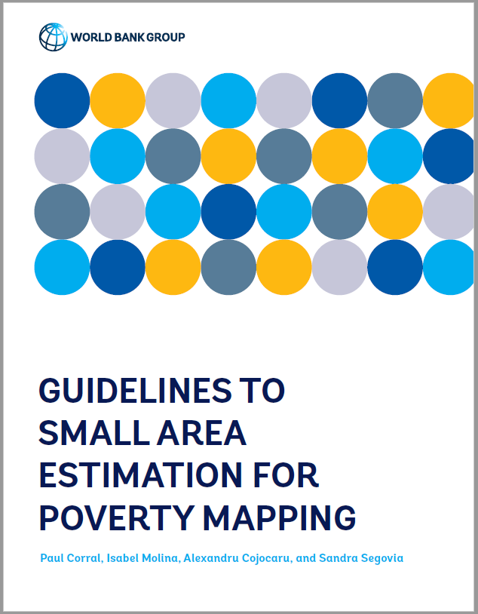
The guidelines assist with the suggested quality control process for poverty maps
While doing the maps we are always available for consultations and advice
Once done, it is recommended teams submit their report and codes for review
Since methods have changed, it’s important we get the methodology sections right, and that models and assumptions are fully checked
There is a set of people within the Poverty GP who can serve as reviewers
Individual teams are usually asked to cover the reviewer’s times
Deviations from recommendations require proper justification and validation
All caveats noted for the methodology should be stated

Slide 3
The Game Plan
We will be following the new Guidelines to SAE for poverty mapping
Corral, P., Molina, I., Cojocaru, A., and Segovia, S. (2022). Guidelines to small area estimation for poverty mapping. The World Bank, Washington, DC. http://hdl.handle.net/10986/37728
Download repository for training: https://github.com/pcorralrodas/wb_sae_training
Download the latest packages used throughout the guidelines:
Unit-level models: https://github.com/pcorralrodas/SAE-Stata-Package
Area-level models: https://github.com/jpazvd/fhsae
Also make sure you have groupfunction and sp_groupfunction: https://github.com/pcorralrodas/groupfunction and https://github.com/pcorralrodas/sp_groupfunction
We will discuss a topic briefly and jump to the Stata do files to see for ourselves how things work and the assumptions underlying the methods
This GitHub repo for the training will be a living repo. I will update it as deemed necessary.
If you want to contribute, please let me know and you can create a branch and we add stuff. I will add you to the list of collaborators.

Slide 4
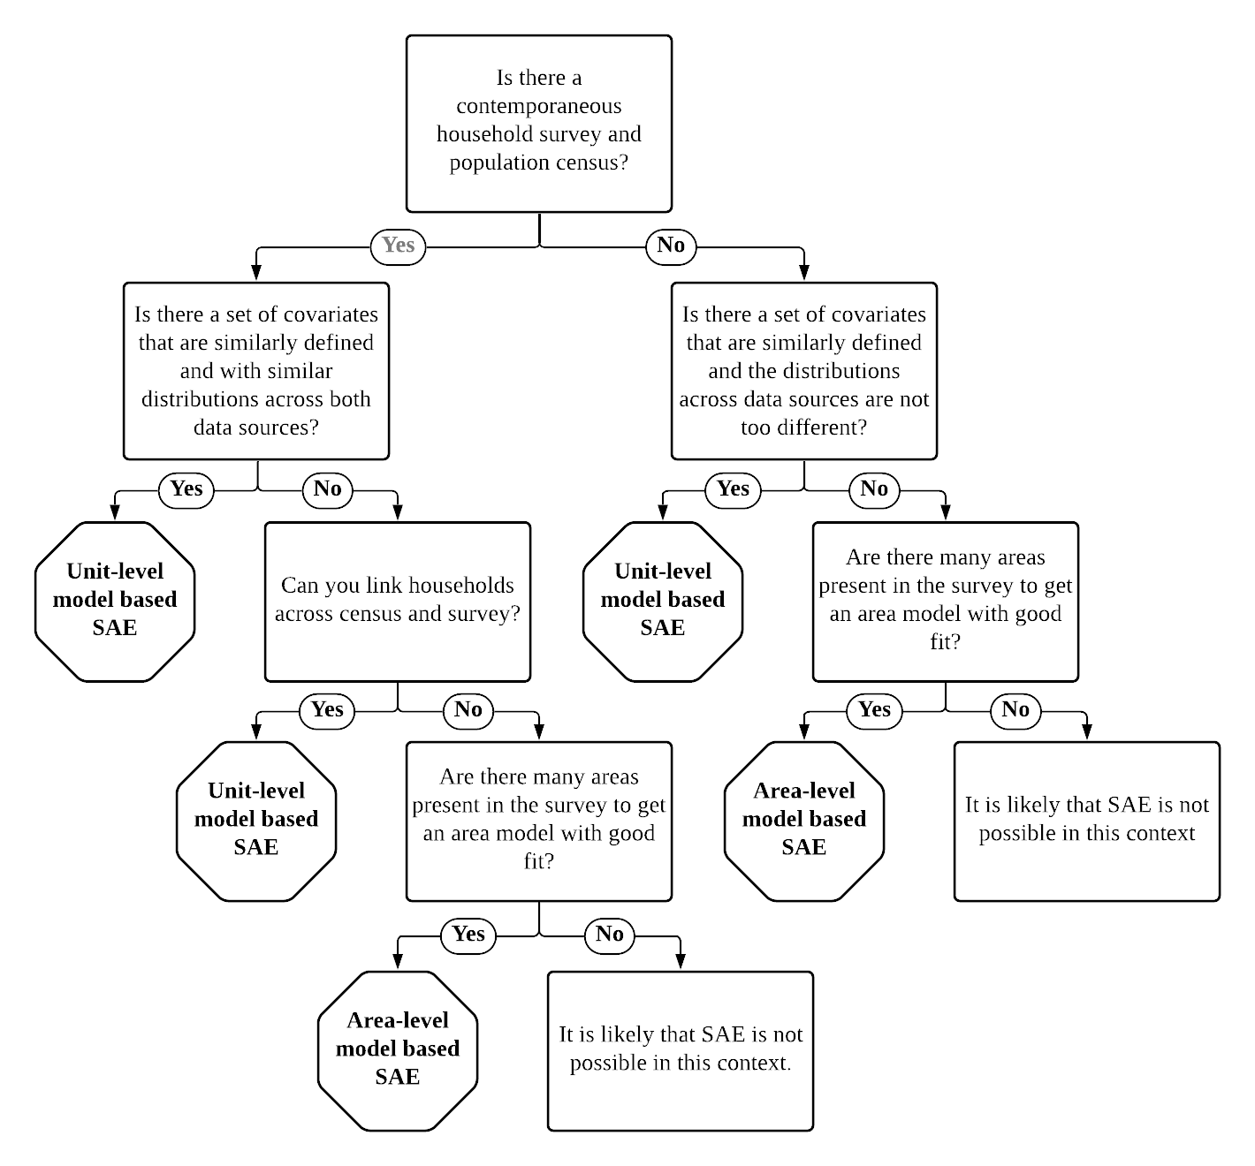
The guidelines present a simple decision tree on what may be the recommended approach for your data environment…as we learn more about other methods, we hope to expand it

Slide 5
Small Area Estimation
Area level models
Training prepared for Summer University 2022
Paul Corral (pcorralrodas@worldbank.org)

Slide 6
What is Necessary to do an Area-level Poverty Map?
Target indicators:
General indicators such as….Including Proportions, means….
Data requirements:
Direct estimates of indicators of interest and its sampling variance for the areas considered (from the survey).
Aggregate data at area level of all necessary covariates for the model for every area considered.
Additionally, we need a location variable to link the census (or any other auxiliar data) and survey at that level.

Slide 7
Fay Herriot models are the traditional approach for cases where access to microdata is not possible or when the census and survey are not aligned
Fay Herriot models were introduced to estimate mean per capita income in small areas in the USA (Fay and Herriot 1979)
The method consists of modelling poverty rates (or other indicators) at the area level
The resulting estimate is a weighted average between the direct estimates (those derived directly from the survey) and the model-based estimates
The weight given to each estimate in a given area depend on the sample size for that area and the quality of the model
For areas not in the sample we rely solely on the model-based estimates
Because the model is only fit on sampled areas as opposed to households, the estimates obtained are often much less efficient than those obtained under unit-level models
Notes:
Fay Herriot in 1979 introduced a model for small area estimation. The model was initially used to estimate mean per capita income in small areas, counties if I’m not mistaken, in the US
For poverty mapping the method models area level poverty rates using area level covariates, so the number of observations is much lower than those of the recently discussed models. Since less information is embedded in the models they tend to be less efficient.
Empirical best estimates are obtained in the model through taking a weighted average between the survey estimates for a given area and the model based estimate (XB). The weights are determined by the quality of the model and on the sample’s quality for that area.
So how do Fay-Herriot models perform when compared to the previous models?

Slide 8
Pros & Cons of Area-level (with Fay-Harriot model) estimation:
<Guidelines 3.3. Pros and Cons of Fay-Herriot Models>
* Also mention what if we want to aggregate FH estimates?

Slide 9
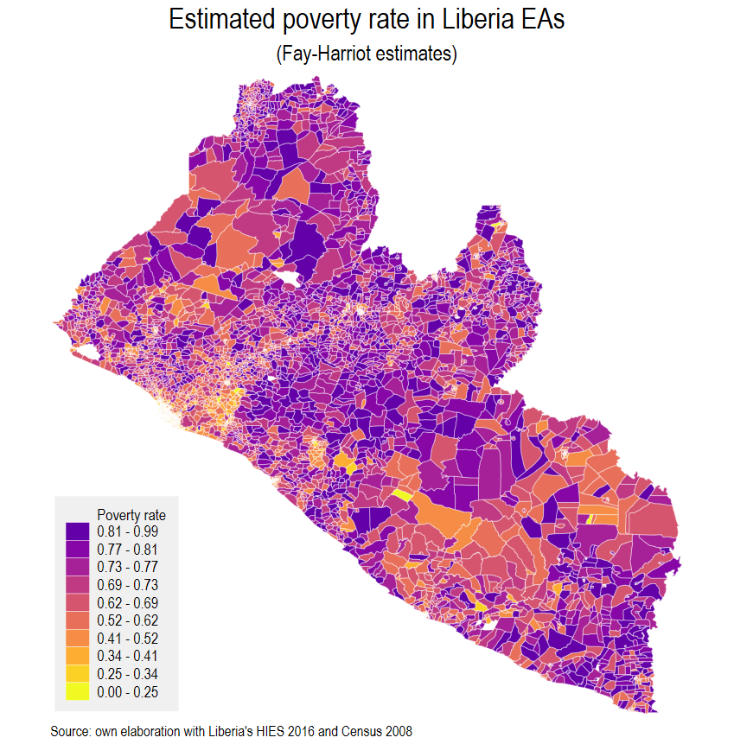
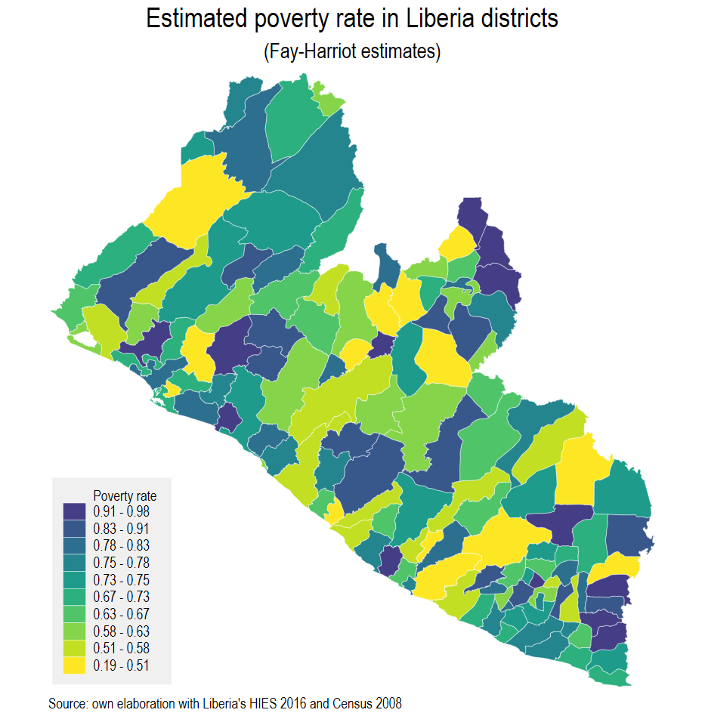
Example: Liberia 2016
Unit-level SAE wasn’t possible
Liberia’s survey is from 2016
Liberia’s Census is from 2008
We model the spatial distribution of poverty in the corresponding survey year
The method is ideal for off-census years, but since we use less information for the model it yields noisier estimates than unit-level SAEs
When data is available at a lower level than the reporting one FH estimates can be aggregated to higher levels with corresponding estimated MSE

Slide 10
Conducting Your First SAE Application with the Fay-Herriot Model for GHANA <year>
Index / Specific plan for the exercise:
A bit of theory is necessary:
FH model and highlight parameters we want to estimate ( don’t forget explaining location effects!) (1 slide)
Show the max problem solved by BLUP. Show solution and the good properties of BLUPs. Add reference to proof (1 slide)
Fitting methods ( show options) – but focus on FH fitting method (is that the formal name?) or is it Prasad and Rao? (1 slide)
What about the MSE? – I think it’s important to show explain a bit more about how is the MSE estimated (1 slide)
Application for GHANA:
5) Direct estimates for indicator at area level of interest. < list indicator and geographic levels>
6) Decision about the (sampling) variance
7) Calculate covariates ( from census, or other auxiliary data) at the area level of interest.
8) Model selection – check assumptions ( don’t forget about location effects)– show “final” fitted model too?
9) Evaluate estimates. Assess model
10) Show map.

Slide 12
Small Area Estimation
Unit level models
Training prepared for Summer University 2022
Paul Corral (pcorralrodas@worldbank.org)

Slide 13
Material available at: https://github.com/pcorralrodas/wb_sae_training
Training prepared for Summer University 2022
Paul Corral (pcorralrodas@worldbank.org)

Slide 14
Main references for unit-level small area estimation
Elbers, C., Lanjouw, J. O. [Jean O], & Lanjouw, P. (2003). Micro–level estimation of poverty and inequality. Econometrica, 71 (1), 355–364.
Molina, I., & Rao, J. (2010). Small area estimation of poverty indicators. Canadian Journal of Statistics, 38 (3), 369–385.
Marhuenda, Y., Molina, I., Morales, D., & Rao, J. (2017). Poverty mapping in small areas under a twofold nested error regression model. Journal of the Royal Statistical Society: Series A (Statistics in Society), 180 (4), 1111–1136.
To learn about the updates
Corral, P., Molina, I., & Nguyen, M. C. (2020). Pull your small area estimates up by the bootstraps. Journal of Statistical Computation and Simulation, 91(16), 3304-3357.
Corral, P., Himelein, K., McGee, K., & Molina, I., (2021). A Map of the Poor or a Poor Map? Mathematics 9, no. 21: 2780. https://doi.org/10.3390/math9212780
Corral. P., Molina, I., Cojocaru, A., & Segovia, S. (2022). Guidelines to Small Area Estimation for Poverty Mapping.

Slide 15
Introduction
Monetary poverty (FGT0) is a non-linear parameter
Initial work at the WB was done by Hentschel, Lanjouw, Lanjouw, and Poggi (1998) but ignored random location effects – we’ll se later why that matters
The welfare distribution is simulated in the census data based on parameters estimated using household survey data which has detailed information on welfare
This yields a welfare value for every single household in the census
Simulating the full welfare distribution allows for estimates beyond just poverty and mean welfare for a given area.
Elbers, Lanjouw and Lanjouw (2003) improved on the method
It was the go-to method for poverty maps done by the World Bank or with the World Bank’s assistance until ~2015
The latest Stata sae package can be obtained from: https://github.com/pcorralrodas/SAE-Stata-Package

Slide 16
Criticism and the publication from Molina and Rao’s EB method led the institution to update methods
In a review of World Bank research, the ELL method was scrutinized by Banerjee et al. (2008)
The reviewers were concerned that the method may not accurately present the true precision of the method’s estimates – among other things
Haslett (2010) recommended adjusting the fitting method described in ELL (2002)
Indicated it leads to an asymmetric variance-covariance matrix
Molina and Rao (2010) showed in simulation studies that ELL is noisy and underperforms under the model’s assumptions
Showed that EB methods are considerably superior and yield substantially less noisy estimates
A shift to Molina and Rao’s EB methods by the World Bank and its toolkit is detailed in Corral, Molina and Nguyen (2020)

Slide 17
The Game Plan
You have a set of do-files in the shared repository
Please make sure you’ve downloaded that repo: https://github.com/pcorralrodas/wb_sae_training
Also make sure you have the sae package: https://github.com/pcorralrodas/SAE-Stata-Package
Also make sure you have groupfunction and sp_groupfunction: https://github.com/pcorralrodas/groupfunction and https://github.com/pcorralrodas/sp_groupfunction
We will discuss a topic briefly and jump to the Stata do files to see for ourselves how things work and the assumptions underlying the methods
This GitHub repo for the training will be a living repo. I will update it as deemed necessary.
If you want to contribute, please let me know and you can create a branch and we add stuff. I will add you to the list of collaborators.

Slide 18
What is Necessary in order to do a Unit-level Poverty Map?
Household survey and Census must have variables in common between them
Questions should be defined in a similar manner in both data sources
Variables should have similar distributions
Common variables should be sufficiently correlated with the welfare measure of interest (income or consumption)
Additionally, we need a location variable in order to link the census and survey at that level

Slide 19
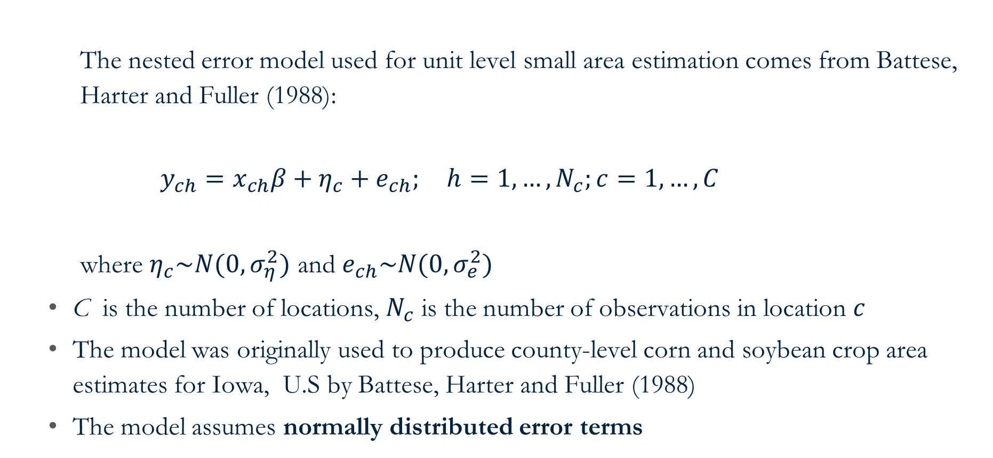
The assumed model used for unit-level SAE
The nested error model used for unit level small area estimation comes from Battese, Harter and Fuller (1988):
$y_{ch}=x_{ch}β+η_{c}+e_{ch}; h=1,…,N_{c};c=1,…,C$
where $η_{c}\sim N(0,σ_{η}^{2})$ and $e_{ch}\sim N(0,σ_{e}^{2})$
C is the number of locations, $N_{c}$ is the number of observations in location $c$
The model was originally used to produce county-level corn and soybean crop area estimates for Iowa, U.S by Battese, Harter and Fuller (1988)
The model assumes normally distributed error terms

Slide 20
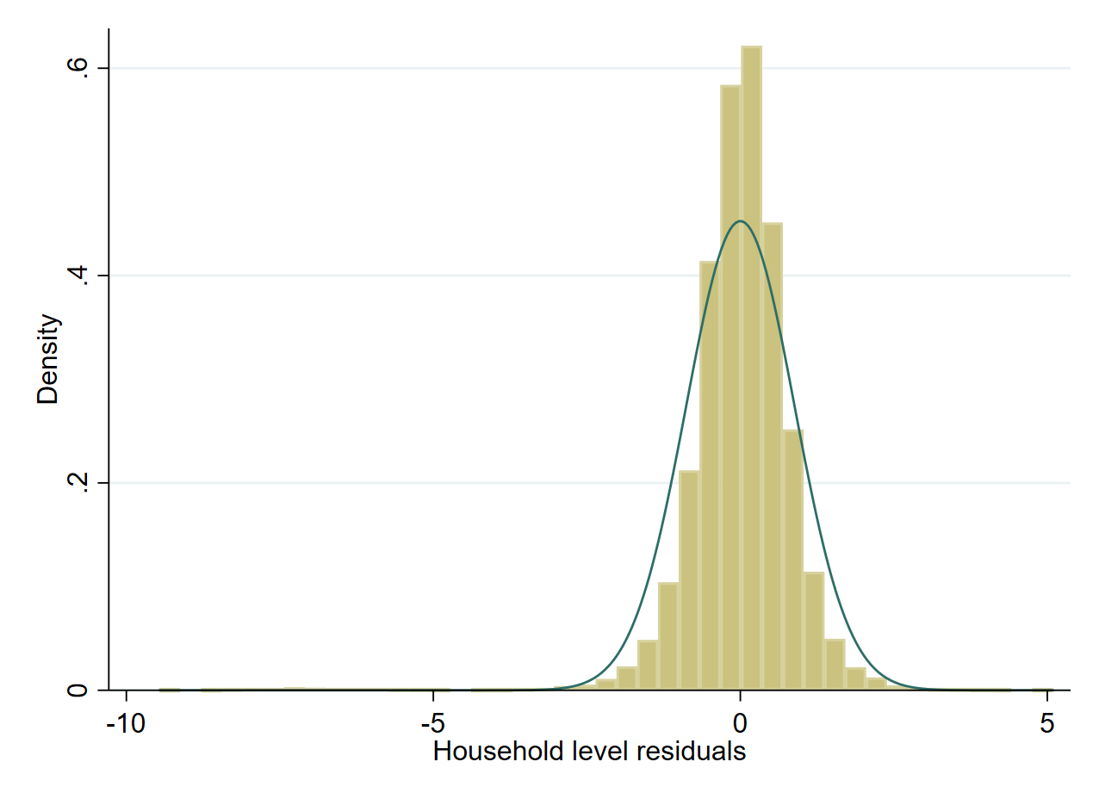
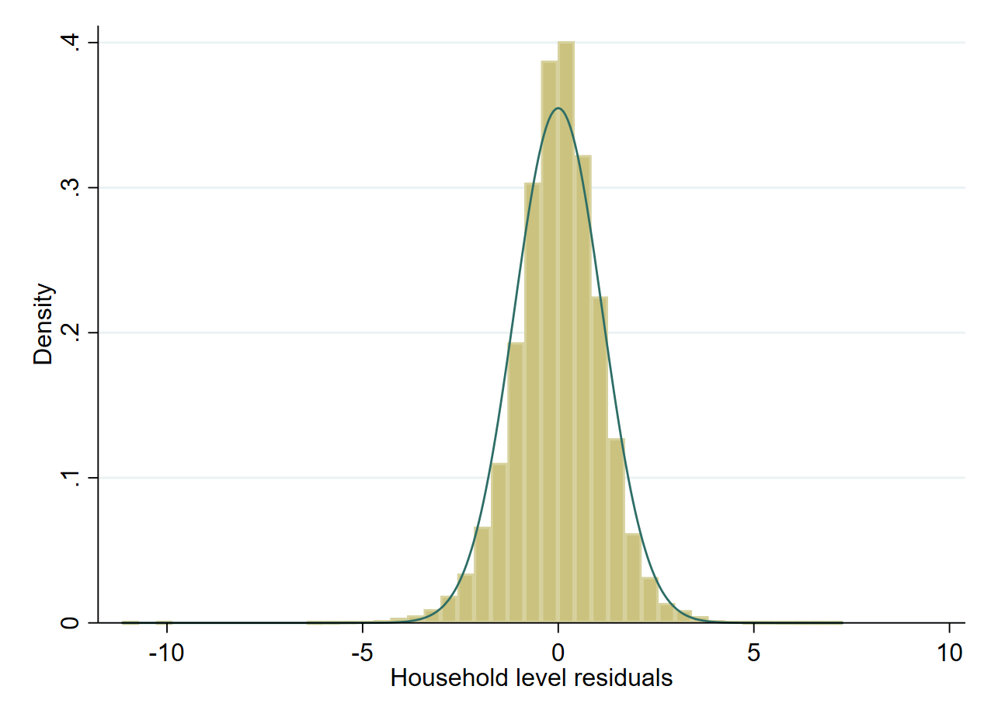
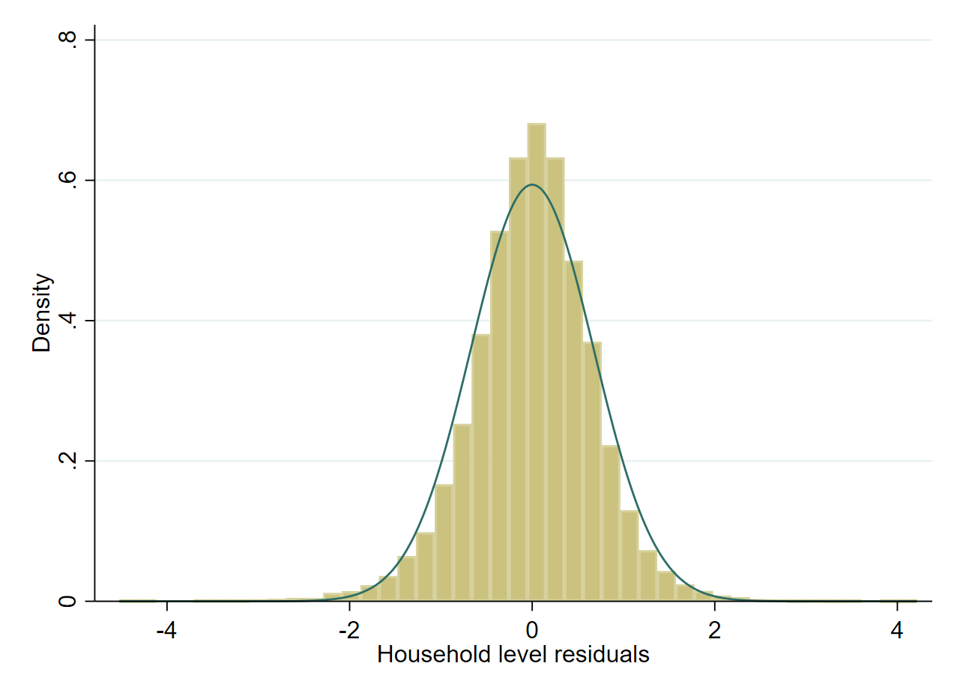
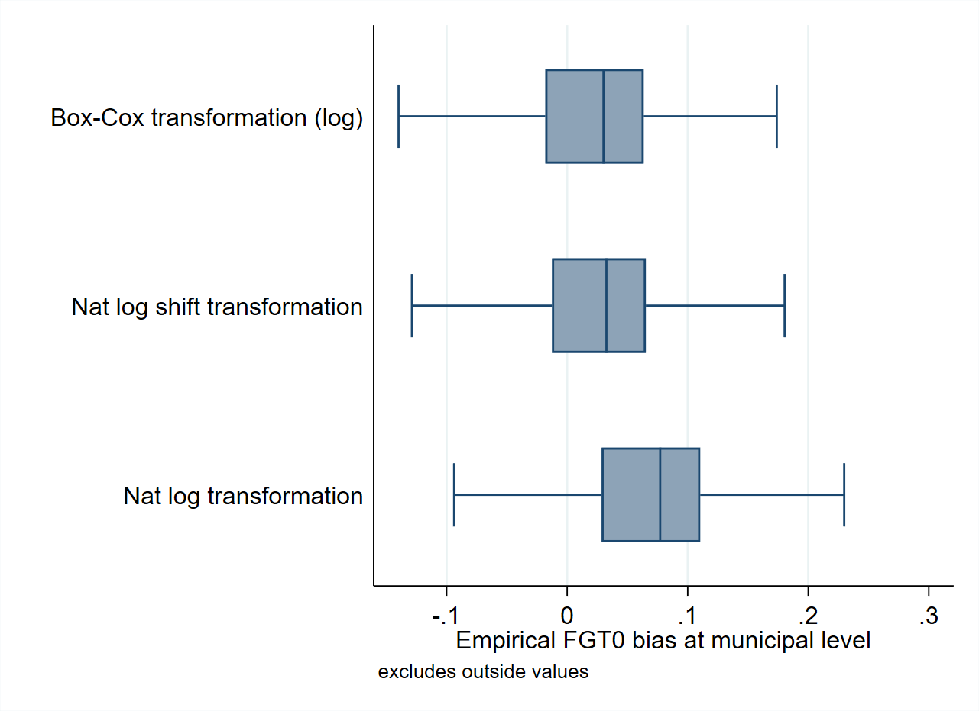
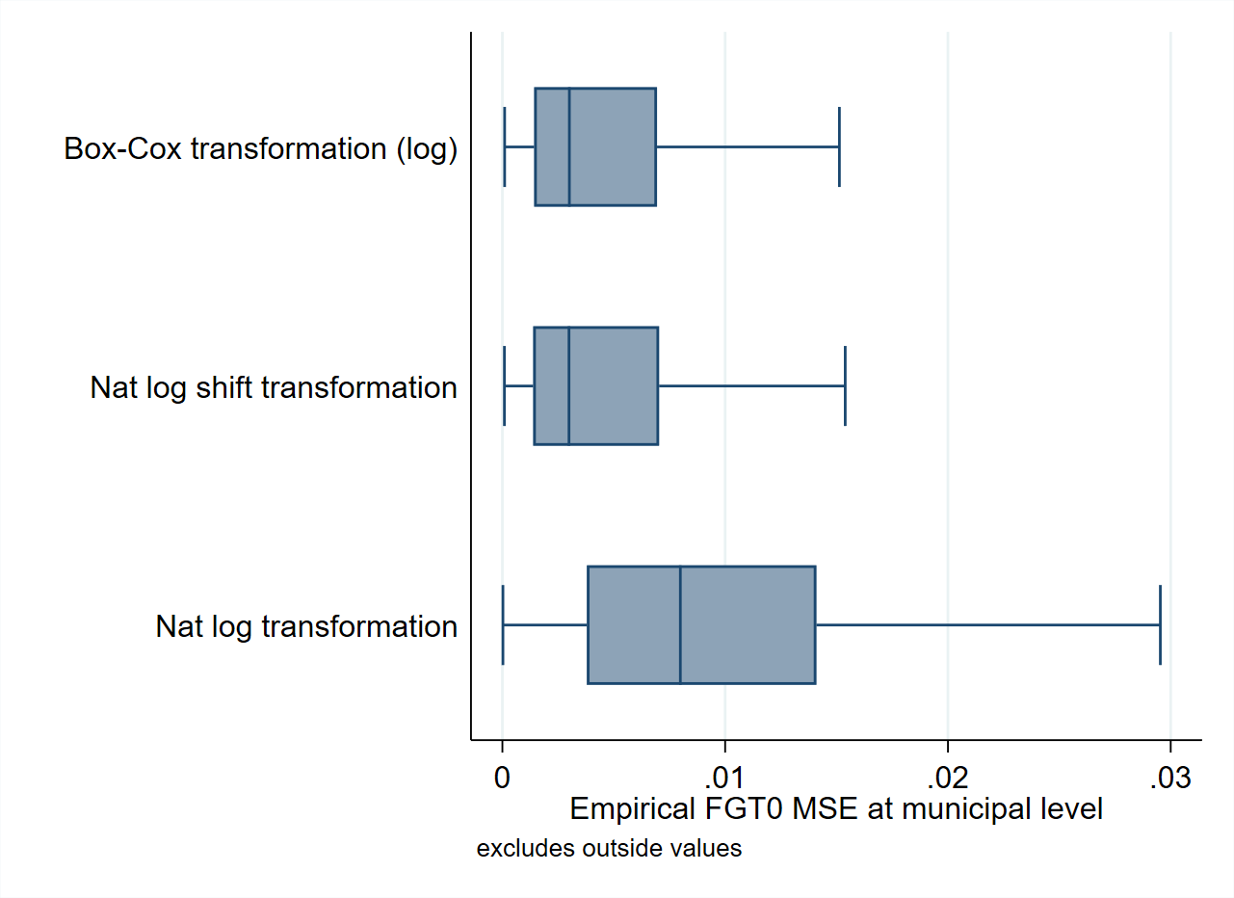


Transformation is necessary to achieve an approximately normal distribution
Nat. log
Box-Cox of Nat. log
Log shift
Bias ($CEB_{a}$)
MSE ($CEB_{a}$)
Notes:
-

Slide 21
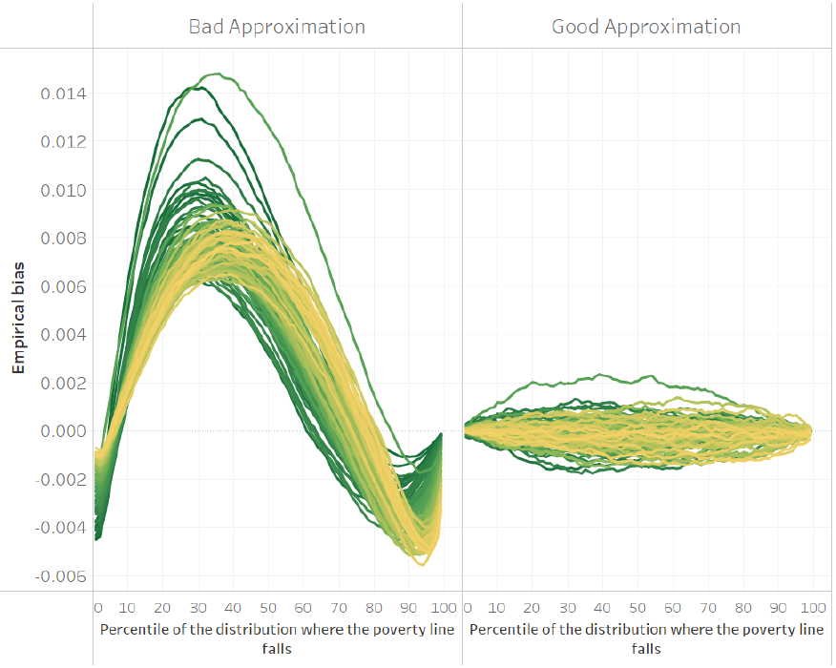
Transformation is necessary to achieve an approximately normal distribution
The implemented SAE methodology relies on approximating as closely as possible the welfare distribution
A model that that approximates the welfare distribution poorly may yield a decent estimate for a given poverty line, yet when judged at a different poverty line the method may completely fail
You can see this in the figure on the left.
A model where the model’s assumptions are imperfectly met may lead to the far-left figure. It will approximate values at certain thresholds but will do a poor job at others.
The model with good approximation has values which are adequate for every single area and threshold.
New “sae” codes allow for transformations beyond the natural log so that the assumptions can be better met.
The x-axis represents the percentile corresponding to a defined poverty line, the y-axis is the empirical bias. Each line corresponds to an area. See Corral et al. (2022) for details.
Notes:
-

Slide 22
Let’s now go to Stata to see the assumed model…
Open following do-file:
~01.dofiles/1.assumed_model.do

Slide 23
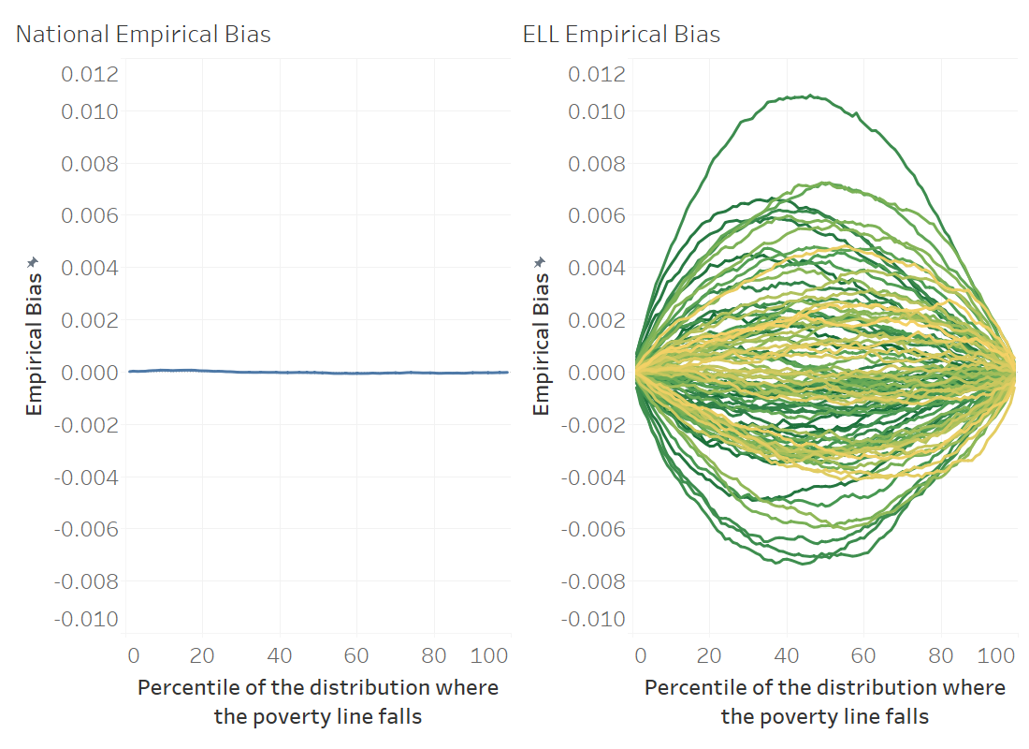
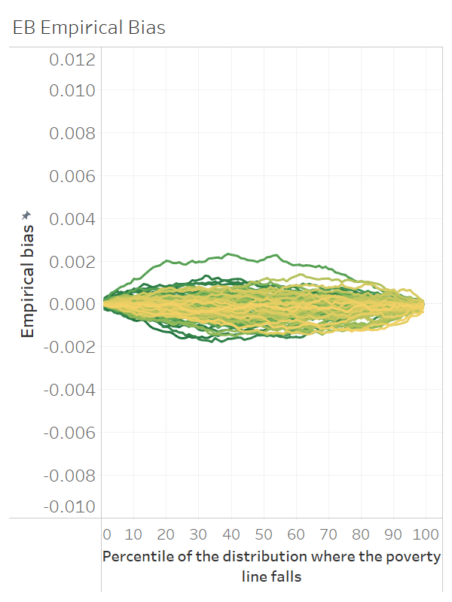
How do EB methods improve upon ELL methods?
EB ensures predictions of the dependent variable at the area level are aligned to the survey – best information at hand
At the national level (left) the ELL model works well and predicts poverty accurately across the welfare distribution
At the area level, because of the lack of EB, the method is less reliable and predictions for a given area show more bias than EB which leads to larger MSE
ELL and EB results from simulation where headcount poverty estimates are obtained under 99 different poverty lines covering the 99 percentiles of the simulated welfare distribution

Slide 24
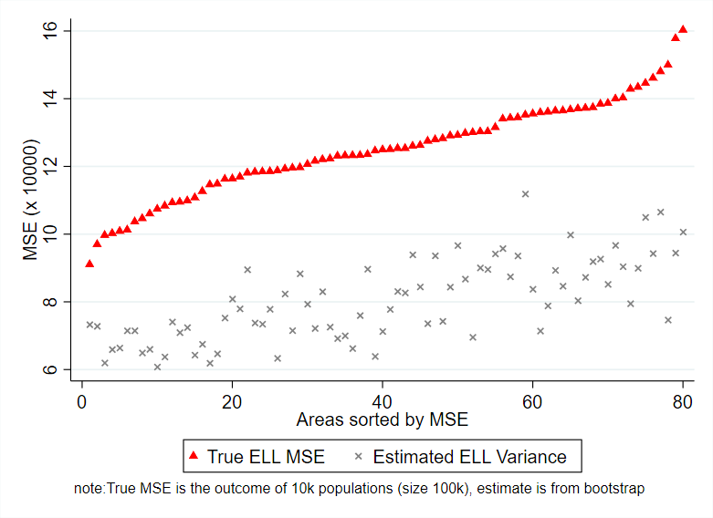
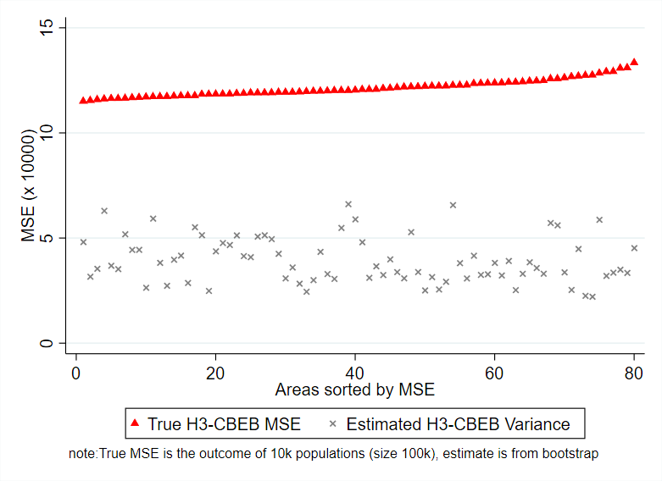
Also, due to the MI type of approach used in PovMap the noise of ELL and EB estimates was underestimated
See Corral, Molina, Nguyen (2021) for more details

Slide 25
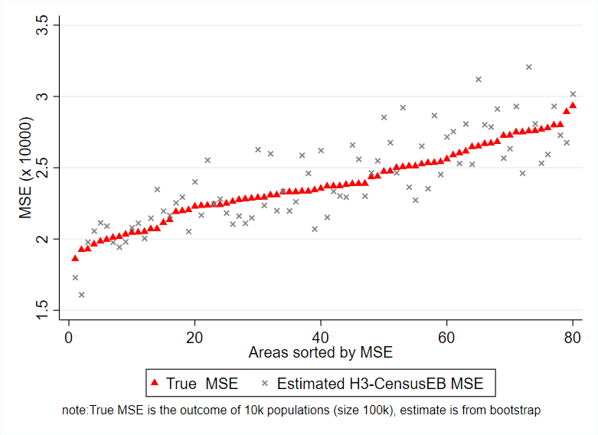
The MSE estimates from the parametric bootstrap (Gonzales-Manteiga et al. 2008) used for the CensusEB, EB, and Two-Fold models in the updated Stata sae package are aligned to the empirical MSE
See Corral, Molina, Nguyen (2021) for more details

Slide 26
Let’s now go to Stata and see how ELL differs from EB
Open the following do-file:
~01.dofiles/2.ELLvsEB.do

Slide 27
Molina and Rao (2010) through simulations show that EB methods are considerably less noisy than ELL. While Corral, Molina and Nguyen (2020) showed that ELL and the initial EB implementation in PovMap lag Molina and Rao’s EB method in terms of MSE
ELL’s MC implementation in PovMap was inspired on the multiple imputation (MI) literature
The goal in MI is not to minimize the MSE
When EB was implemented in PovMap a similar MI approach was attempted
This led to noisy and biased EB estimates
This is documented and corrected in Corral, Molina, and Nguyen (2021)
ELL and EB implemented in PovMap
Molina and Rao’s (2010) EB methods
Simulations from Molina and Rao (2010) conducted in Corral, Molina, Nguyen (2021)

Slide 28
Let’s now go to Stata and see how to validate a method through model-based simulations
Open the following do-file:
~01.dofiles/3.ModelBasedSim.do

Slide 29
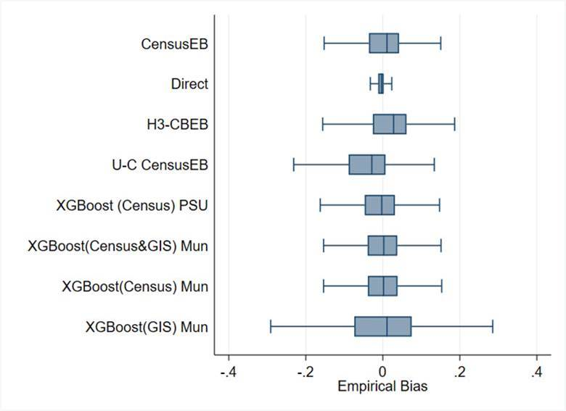
What about machine learning approaches? A validation with real world data...
FGT0 Bias (mun. level for 1,865 mun.)
Still work in progress… Working Paper coming before the end of the summer (2022)
All methods rely on census household and/or area aggregate covariates, unless stated otherwise
Notice the bias of the different methods
Direct estimates are the least biased
Notice how the box-plot for unit context models, those that model household level welfare using only area level covariates, is downward biased
XGboost yields good results. In some cases as good as censusEB
Results for XGboost from models using just GIS covariates are less stellar
Mexican intra-censal survey used as a census for design-based simulation based on 500 samples.
Notes:
-

Slide 30
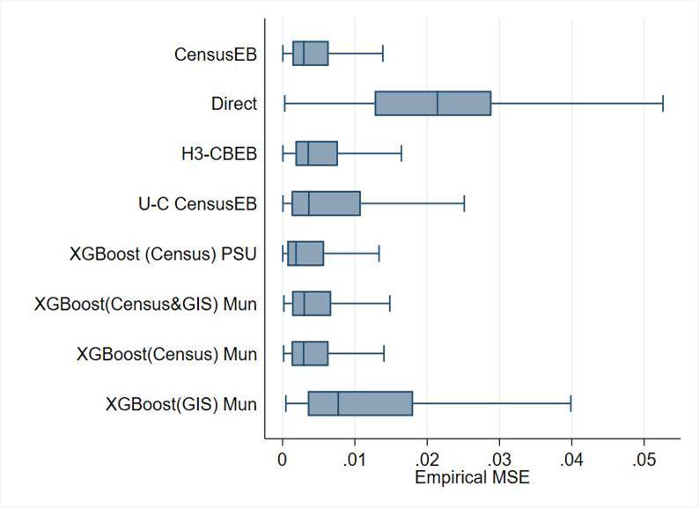
What about machine learning approaches? A validation with real world data...
Notice the MSE of the different methods
Direct estimates are the least biased, but noisiest
XGboost fit at the municipal level with just GIS covariates is the second noisiest
CensusEB, as expected, shows the smallest MSE, followed very closely by XGboost fit at the PSU level with just census aggregates
XGboost in this scenario outperforms unit-context models as those presented by (Masaki et al. 2020)
MSE (mun. level for 1,865 mun.)
Mexican intra-censal survey used as a census for design-based simulation based on 500 samples.
Notes:
-

Slide 31
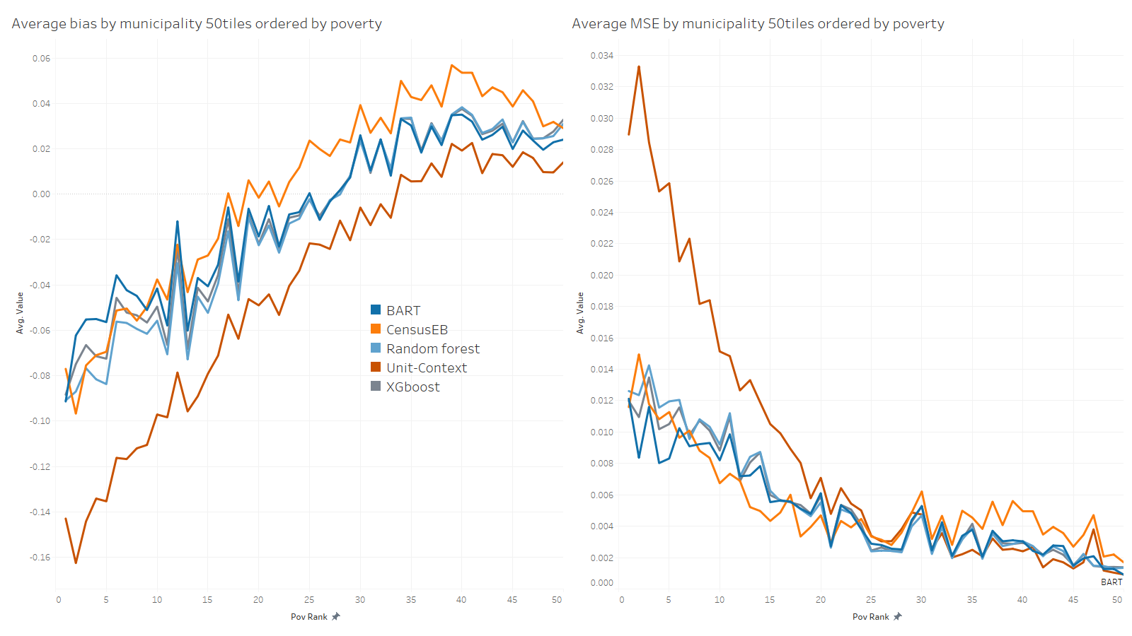
The bias and MSE are worse among poorer municipalities which may have considerable consequences for targeting
Mexican intra-censal survey used as a census for design-based simulation based on 500 samples.
Notes:
-

Slide 32
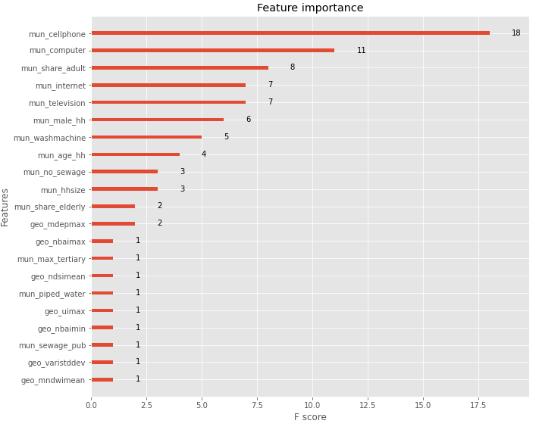
It all depends on the quality of the data!
The model works best with census data aggregates
When combining census aggregates and GIS covariates the method leans towards census aggregates
The empirical MSE of the gradient boosting models is smaller when only using census aggregates
In this scenario it suggests that census aggregates are better than GIS at explaining the variation of area level poverty
Covariates with mun_ prefix are derived from the census, geo_ are GIS covariates…
Notes:
evi: Enhanced Vegetation Index
ndvi: Normalized Difference Vegetation Index
ndbi: Normalized Difference Built-up Index
bu: Built-up Index
sr: Simple Ratio
arvi: Atmospherically Resistant Vegetation Index
ui: Urban Index
ibi: Index of biological integrity
ndwi: Normalized Difference Water Index
mndwi: Modified Normalized Difference Water Index
nbi: New Built-up Index
brba: Band Ratio for Built-up Area
nbai: Normalized Built-up Area Index
baei: Built-up Area Extraction Index
ndsi: Normalized Difference Snow Index
vari: Visible Atmospherically Resistant Index
savi: Soil Adjusted Vegetation Index
osavi: Optimized Soil Adjusted Vegetation Index
ndmi: Normalized Difference Moisture Index
mdea = Altitude from digital model
mdep = slope from digital model

Slide 33
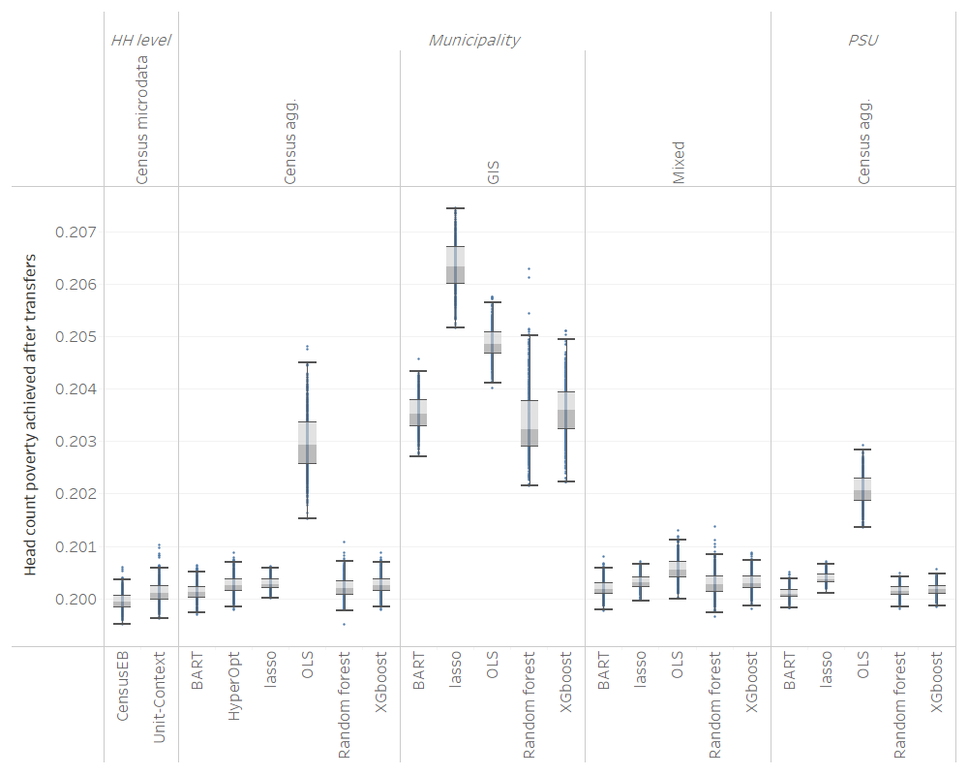
Does it matter for allocation of transfers?
Transfer budget is equal to the poverty gap of the population (census)
Original poverty is 25%
Using true poverty ranking we achieve poverty of 19.9% by giving all in the poorest areas the same transfer amount (budget/total number of poor)
Some methods do a better job than others, but in the end, something is better than nothing!
Notes:
evi: Enhanced Vegetation Index
ndvi: Normalized Difference Vegetation Index
ndbi: Normalized Difference Built-up Index
bu: Built-up Index
sr: Simple Ratio
arvi: Atmospherically Resistant Vegetation Index
ui: Urban Index
ibi: Index of biological integrity
ndwi: Normalized Difference Water Index
mndwi: Modified Normalized Difference Water Index
nbi: New Built-up Index
brba: Band Ratio for Built-up Area
nbai: Normalized Built-up Area Index
baei: Built-up Area Extraction Index
ndsi: Normalized Difference Snow Index
vari: Visible Atmospherically Resistant Index
savi: Soil Adjusted Vegetation Index
osavi: Optimized Soil Adjusted Vegetation Index
ndmi: Normalized Difference Moisture Index
mdea = Altitude from digital model
mdep = slope from digital model

